Slide 1
Segmenting and Clustering Neighbourhoods in Fredericton
Applied Data Science Capstone Project – Week 5

Slide 2
Motivation
Which Fredericton neighbourhoods have the highest crime count?
What is the count of the different crime types in Fredericton?
Which neighbourhoods are the safest in Fredericton?
What are the geographical coordinates of Fredericton and its
neighbourhoods?
What insight about the different neighbourhoods can be obtained by using
the Foursquare data?

Slide 3
Datasets
1. Crime by neighbourhood 2017 / Crime par quartier 2017
http://data-fredericton.opendata.arcgis.com/datasets/0ff4acd0a2a14096984f85c06fe4e38e_0
2.Fredericton - City, New Brunswick, Canada
http://www.city-data.com/canada/Fredericton-City.html
3. Fredericton - Wikipedia
https://en.wikipedia.org/wiki/Fredericton
4. Fredericton - City, New Brunswick, Canada
http://www.city-data.com/canada/Fredericton-City.html

Slide 4
Methodology
Import required libraries and packages.
Load each datasets.
Explore each datasets.
Use Foursquare data to explore specific locations of interests.
Perform K-means clustering algorithm.
Produce useful visualization of key results.

Slide 5
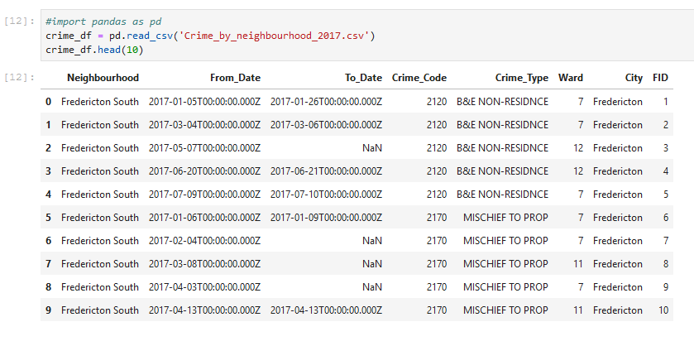
Dataset before cleaning

Slide 6
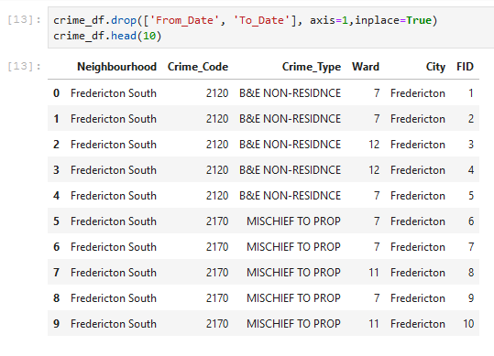
Dataset after some cleaning

Slide 7
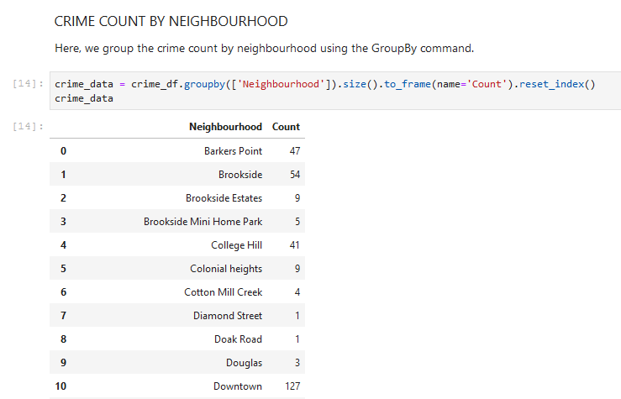
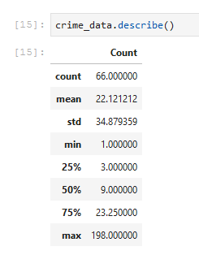
Crime Count by neighbourhood & Statistical description
Average crime count by neighbourhood is 66

Slide 8
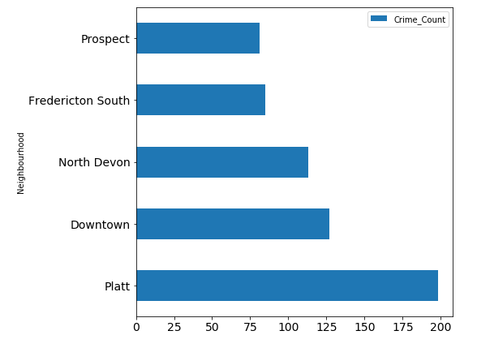
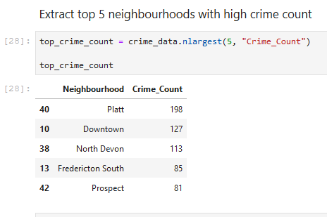
Top 5 neighbourhoods with highest crime count
Platt= 198
Downtown = 127
North Devon = 113
Fredericton South = 85
Prospect = 81

Slide 9
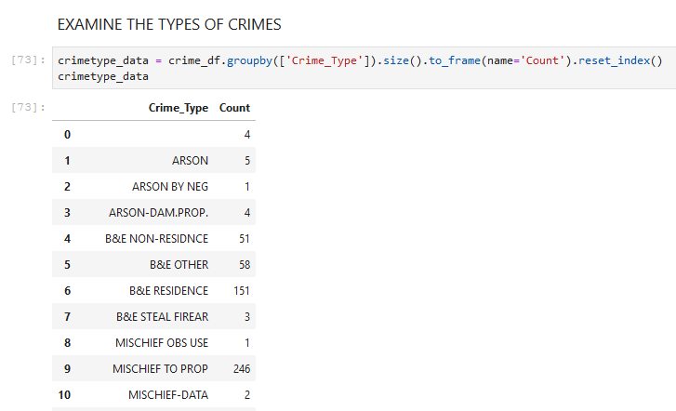
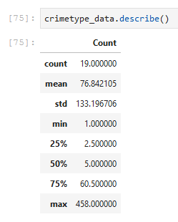
Frequency of different crime types & Statistical description

Slide 10
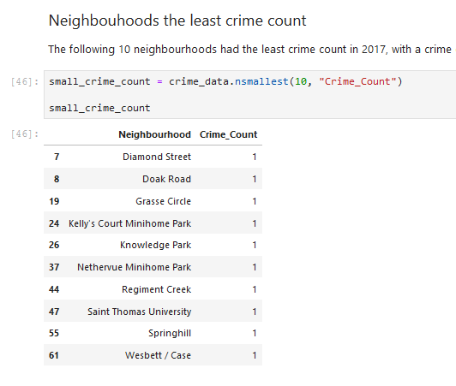
Neighbourhoods with least crime count in 2017
These 10 neighbourhoods witnessed
only a single crime incident in 2017.
As a result, they were presumed to
be the safest then.

Slide 11
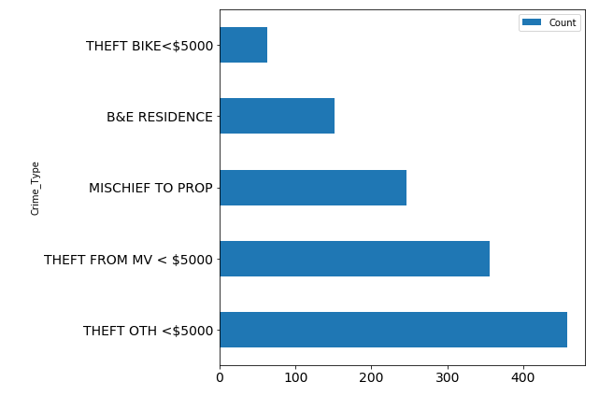
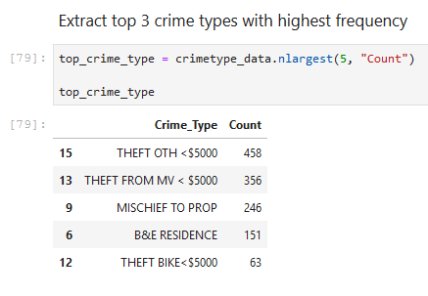
Top 5 frequent crime types in Fredericton neighbourhoods

Slide 12
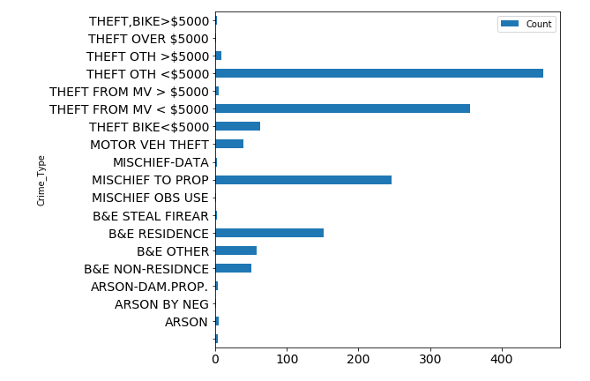
Proportion of different crime types that occurred in 2017

Slide 13
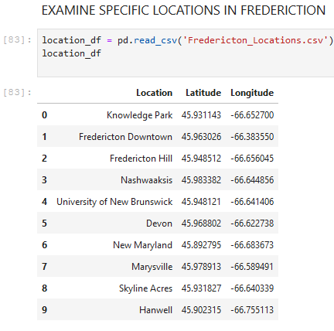
Specific locations in Fredericton & their geographical coordinates

Slide 14
Conclusion
This work mainly explored the “Crime by Neighbourhood 2017” open dataset provided by the City of Fredericton coupled with the Foursquare data.
We also explored the geographical coordinates of the neighbourhoods of Fredericton.
Identified crime count and frequency of crime type count by neighbourhoods.
Identified top 5 neighbourhoods with the highest crime counts in 2017.
Identified 10 neighbourhoods with least crime counts in 2017. Hence, these neighbourhoods were presumed to be the safest in then.

